Slide 1
TITLE
The Effect of Anti-Inflammatory Dietary Approaches on Metabolic, Reproductive, and Inflammatory Health in Women: A Systematic Review
BY BAILEY OLIVER

Slide 2
INTRODUCTION
Connection between Diet and Disease
  The foods we consume impact inflammation, hormone regulation, gut health, and metabolic processes.
  Western dietary patterns high in sugar, saturated fats, and refined carbs promote chronic low-grade inflammation.
  Inflammation is a key driver in endocrine disorders like PCOS, thyroid dysfunction, and infertility.
  These diseases are usually treated with medications as a first line of defense.

Slide 3
BACKGROUND
Pathophysiology
Prevalence
  PCOS: Characterized by insulin resistance and irregular ovulation.
  Hypothyroidism: Often autoimmune (Hashimoto’s); affects metabolism, menstrual regularity, and ovulation.
  Infertility: Hormone imbalance (e.g., LH/FSH, TSH), inflammation, and poor egg quality are common contributors.
  PCOS: Affects ~10–13% of reproductive-age women.
  Hypothyroidism: Impacts ~5% of women.
  Infertility: ~11% of women experience infertility (CDC); 30–40% of female infertility cases are linked to hormone disorders like PCOS or thyroid dysfunction.

Slide 4

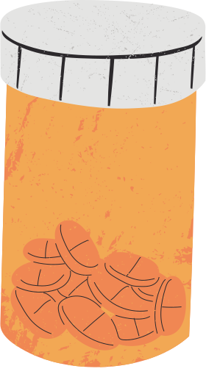
BACKGROUND
Cost
  Clomiphene or Letrozole (for ovulation induction): ~$100–$300/month without insurance.
  Injectable gonadotropins (e.g., FSH/LH): $1,000–$3,000+ per cycle.
  IVF: $15,000–$25,000 per cycle.
  Thyroid medications (e.g., levothyroxine): ~$10–$50/month (generic), but long-term reliance may not resolve underlying inflammation.

Slide 5
BACKGROUND
The Connection with Diet
  Targets root causes: chronic inflammation & insulin resistance
  In PCOS:
    Improves insulin sensitivity → ↓ androgen levels
    Supports regular ovulation
  In Hypothyroidism:
    ↓ CRP, IL-6, TNF-α → reduces autoimmune activity
    Supports thyroid hormone production
  In Infertility:
    Enhances blood sugar control & reduces oxidative stress
    Optimizes nutrient status (zinc, selenium, iodine, omega-3s)
    Supports hormone production & egg quality

Slide 6


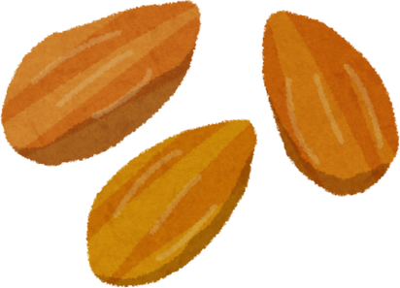



BACKGROUND
  High in: Fruits, vegetables, whole grains, legumes, nuts, seeds, omega-3 fats
  Low in: Ultra-processed foods, added sugars, trans fats
  Includes the Mediterranean diet, DASH Diet, whole foods based diet, plant focused diet
The
Anti-Inflammatory Diet

Slide 7


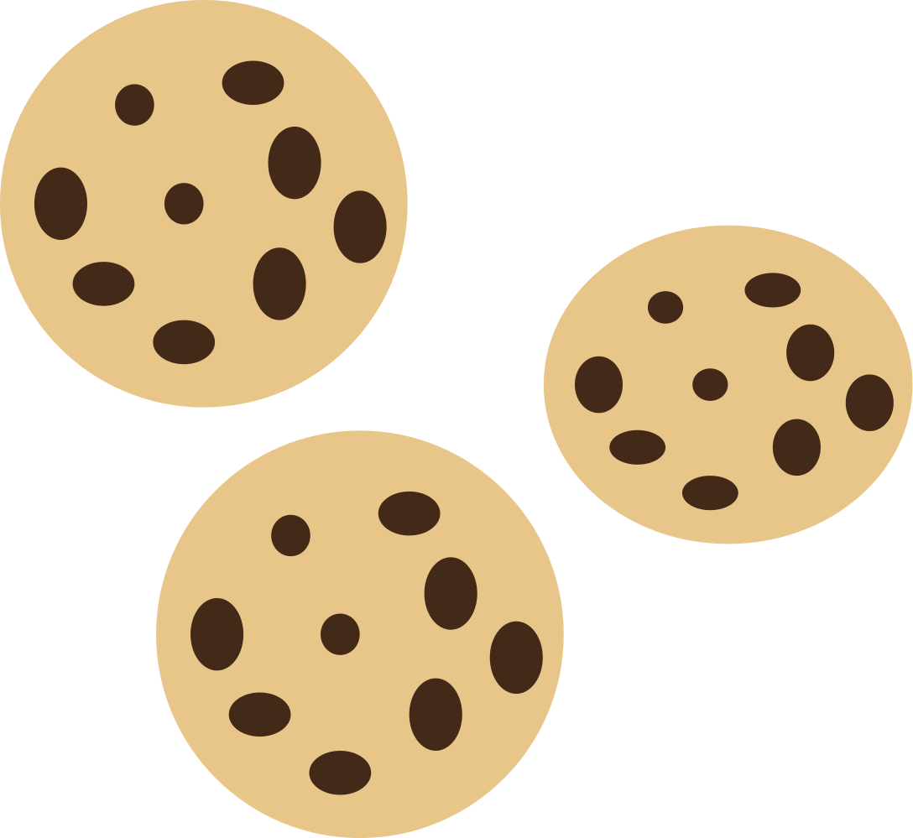



BACKGROUND
  Characteristics of a Western diet: high-fat, processed, low-fiber
  Link to chronic inflammation and hormone disruption, weight gain, increases heart disease risk, cancer risk, liver disease risk
The
Western
Diet

Slide 8
BACKGROUND
Anti-Inflammatory vs Western Diet Plate
Anti-Inflammatory | Western
High fruits and vegetables | High red and processed meats
High Omega 6 and Omega 3 Fatty Acids | High saturated fat
Low sugar intake | Higher sugar intake, and more energy density

Slide 9

METHODS
Study Selection
  PICO framework
  Participants: Women ages 18–50 with or without hormone imbalances
  Intervention: Anti-inflammatory diet
  Comparison: Western or non-Anti Inflammatory diets
  Outcome: Metabolic, inflammatory or reproductive markers

Slide 10

METHODS
Literature Search/Screening
  PubMed database, May 2025\
  Broke search terms into catergories based on diet, disease state, or markers
  Search terms included: "anti-inflammatory diet," "women," "hormones," etc.
  Final studies included: 9

Slide 11

METHODS
Study Design
  6 RCTs,
  2 prospective interventions,
  1 observational
  ~700 participants
  Intervention types: Mediterranean, DASH, AIDiet

Slide 12
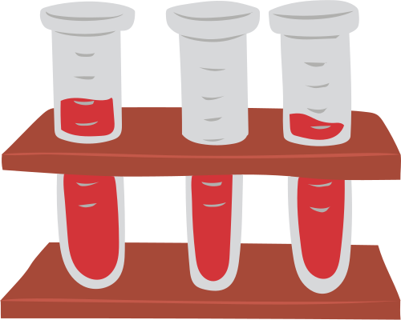

OBJECTIVE
To evaluate effects:
Metabolic markers
Inflammatory markers
Reproductive health markers

Slide 13
METHODS
Page 06
Outcome Catergories
Metabolic:
insulin, glucose, HOMA-IR
Reproductive:
Pregnancy rates, Sex Hormone Binding Globulin (SHBG), menstrual regularity
Inflammatory:
CRP, IL-1, IL-6, TNF-α

Slide 14
RESULTS- METABOLIC MARKERS
Study | Participants | Length | Outcome
Campbell et al. (2024) | 66 women with breast cancer | 8 weeks | Fasting Insulin: ↓ HOMA-IR (Insulin Resistance): ↓ Fasting Glucose: ↓ Triglycerides: ↓
Mizgier et al. (2024) | 32 girls, normal and overweight/obese | 12 weeks | Ov/Ob group: ↓ Fasting insulin levels ↓ HOMA-IR index ↓ Total antioxidant capacity (TAC)

Slide 15
RESULTS- METABOLIC MARKERS
Study | Participants | Length | Outcome
Asemi and Esmaillzadeh (2015) | 48 overweight and obese females with PCOS | 8 weeks | ↓ insulin levels and HOMA-IR in the DASH diet group compared to the control group.
Salama et al. (2015) | 100 females with PCOS | 12 weeks | ↓ weight loss (~7%) ↑ body composition ↑ glucose homeostasis ↑ lipid profiles (LDL, cholesterol, VLDL) ↓ inflammatory markers (CRP and SAA)

Slide 16
RESULTS-INFLAMMATORY MARKERS
Study | Participants | Length | Outcome
Mizgier et al. (2024) | 32 girls, normal and overweight/obese | 12 weeks | ↓ Total antioxidant capacity (TAC) ↓ Interleukin-1 (IL-1) ↓ Interleukin-6 (IL-6) ↓ Tumor Necrosis Factor-alpha (TNF-α)
Roager et al. (2019) | 80 adults | 8 weeks | ↓ body weight ↓ systemic low-grade inflammation markers (CRP)
Asemi and Esmaillzadeh (2015) | 48 overweight and obese females with PCOS | 8 weeks | ↓ hs-CRP in DASH group
Notes:
As we see in this table, anti-inflammatory diets helped lower inflammation levels and markers. Lowering inflammation has been linked with better hormonal balance and cycle regulation.

Slide 17
RESULTS-REPRODUCTIVE MARKERS
Study | Participants | Length | Outcome
Karayiannis et al. (2018) | 244 women undergoing IVF | 3-6 months, depending | ↑ adherence to the Mediterranean diet = ↑ clinical pregnancy rate.
Salama et al. (2015) | 100 females with PCOS | 12 weeks | 63% regained menstrual cyclicity 12% achieved spontaneous pregnancy within 12 weeks
Notes:
As we can see in this table, nutrition can significantly impact fertility outcomes, even within a 12-week window.
** define clinical pregnancy

Slide 18
DISCUSSION
Page 06
Highlights
Anti-inflammatory diets support inflammatory, metabolic, and reproductive health
Consistent improvements across multiple markers
Real potential for clinical application
Notes:
Across all areas, which included metabolic, inflammatory, and reproductive, the data leaned toward anti-inflammatory diets with beneficial effects
*** why on a cellular level does this happen?

Slide 19
DISCUSSION
Metabolic Improvements
  Improved Insulin Sensitivity & HOMA-IR
    Reduces insulin resistance and supports hormonal balance, improving ovulation and fertility.
  Better Blood Sugar Control
    Stabilizes energy and hormones, lowering inflammation and supporting reproductive function.
  Lowered Cholesterol & Triglycerides
    Enhances metabolic and cardiovascular health, promoting healthy hormone production.
  Increased Antioxidant Status
    Protects eggs and reproductive tissues by reducing oxidative stress and inflammation.
  Modest Weight Loss
    Restores hormone regulation and improves fertility markers, especially in PCOS.

Slide 20
DISCUSSION
Inflammatory Improvements
  Decreased IL-1, IL-6, TNF-α
    Lowers chronic inflammation, supporting hormone regulation and reducing PCOS symptoms.
  Reduced CRP
    Indicates less systemic inflammation, promoting better metabolic function and hormone balance.
  Lowered hs-CRP
    Reflects the anti-inflammatory power of nutrient-dense diets, helping to restore hormonal balance.

Slide 21
DISCUSSION
Reproductive Improvements
  Restored Menstrual Cycles & Ovulation
    Anti-inflammatory diets can help regulate hormones and restart natural cycles, supporting spontaneous fertility.
  Improved IVF Outcomes
    Nutrient-dense, anti-inflammatory diets may enhance egg quality and increase chances of pregnancy during assisted reproduction.

Slide 22

DISCUSSION
Limitations of Studies
  Overrepresentation of PCOS populations
  Small sample sizes
  Limited representation of other hormone conditions
  Limitation of self reporting with questionaire based studies

Slide 23
CONCLUSION
Main Conclusions:
  Anti-inflammatory diets improve insulin sensitivity, lower inflammation, support reproductive health
  Validates nutrition as a therapeutic tool and diet change as a healing strategy
  RD’s can be useful in these settings
    Fertility Clinics
    OBGYN Offices

Slide 24
CONCLUSION
Clinical Implications
  Use in individualized nutrition counseling
  Empowering for women seeking non-drug options to be able to change lifestyle and achieve results
  Encourage women to take control of their health by changing lifestyle

Slide 25
CONCLUSION
Future Research
  Explore hypothyroidism, elevated PTH, non-PCOS populations
  Conduct longer RCTs
  Consider dried urine analysis testing for hormone levels, more accurate than blood tests for capturing hormone health over a period of time.

Slide 26
CONCLUSION
Acknowledgements
  Thank you to my Co-Chairs, Dr. Rushing and Laura Gillikin. You both taught me so much about how to conduct correct research for my systematic review and how to apply it in real life settings and my future career as an RD.
  I would also like to thank Mrs. Moreman for being the best mentor and teacher over my entire time at Auburn.

Slide 27
CONCLUSION
References
Asemi, Z., & Esmaillzadeh, A. (2015). DASH diet, insulin resistance, and serum hs-CRP in polycystic ovary syndrome: A randomized controlled clinical trial. Hormone and Metabolic Research, 47(3), 232–238. https://doi.org/10.1055/s-0034-1376990
Brdar, D., Gunjača, I., Pleić, N., Torlak, V., Knežević, P., Punda, A., Polašek, O., Hayward, C., & Zemunik, T. (2021). The effect of food groups and nutrients on thyroid hormone levels in healthy individuals. Nutrition, 91–92, 111394. https://doi.org/10.1016/j.nut.2021.111394
Campbell, T. M., Campbell, E. K., Culakova, E., Blanchard, L. M., Wixom, N., Guido, J. J., Fetten, J., Huston, A., Shayne, M., Janelsins, M. C., Mustian, K. M., Moore, R. G., & Peppone, L. J. (2024). A whole-food, plant-based randomized controlled trial in metastatic breast cancer: Weight, cardiometabolic, and hormonal outcomes. Breast Cancer Research and Treatment, 205(2), 257–266. https://doi.org/10.1007/s10549-024-07266-1
Garcia-Leme, J., & Farsky, S. P. (1993). Hormonal control of inflammatory responses. Mediators of Inflammation, 2(3), 181–198. https://doi.org/10.1155/S0962935193000250
Karayiannis, D., Kontogianni, M. D., Mendorou, C., Mastrominas, M., & Yiannakouris, N. (2018). Adherence to the Mediterranean diet and IVF success rate among non-obese women attempting fertility. Human Reproduction, 33(3), 494–502. https://doi.org/10.1093/humrep/dey003
Malesza, I. J., Malesza, M., Walkowiak, J., Mussin, N., Walkowiak, D., Aringazina, R., Bartkowiak-Wieczorek, J., & Mądry, E. (2021). High-fat, Western-style diet, systemic inflammation, and gut microbiota: A narrative review. Cells, 10(11), 3164. https://doi.org/10.3390/cells10113164
Mentella, M. C., Scaldaferri, F., Ricci, C., Gasbarrini, A., & Miggiano, G. A. D. (2019). Cancer and Mediterranean diet: A review. Nutrients, 11(9), 2059. https://doi.org/10.3390/nu11092059
Mizgier, M., Więckowska, B., Formanowicz, D., Lombardi, G., Brożek, A., Nowicki, M., Durkalec-Michalski, K., Kędzia, W., & Jarząbek-Bielecka, G. (2024). Effects of AIDiet intervention to improve diet quality, immuno-metabolic health in normal and overweight PCOS girls: A pilot study. Scientific Reports, 14(1), 3525. https://doi.org/10.1038/s41598-024-54100-1
Roager, H. M., Vogt, J. K., Kristensen, M., Hansen, L. B. S., Ibrügger, S., Mærkedahl, R. B., Bahl, M. I., Lind, M. V., Nielsen, R. L., Frøkiær, H., Gøbel, R. J., Landberg, R., Ross, A. B., Brix, S., Holck, J., Meyer, A. S., Sparholt, M. H., Christensen, A. F., Carvalho, V., Hartmann, B., … Licht, T. R. (2019). Whole grain-rich diet reduces body weight and systemic low-grade inflammation without inducing major changes of the gut microbiome: A randomised cross-over trial. Gut, 68(1), 83–93. https://doi.org/10.1136/gutjnl-2017-314786
Salama, A. A., Amine, E. K., Salem, H. A., & Abd El Fattah, N. K. (2015). Anti-inflammatory dietary combo in overweight and obese women with polycystic ovary syndrome. North American Journal of Medical Sciences, 7(7), 310–316. https://doi.org/10.4103/1947-2714.161246

Slide 28
CONCLUSION
Thank
You!
Thank you so much for your attention. I'm happy to answer any questions!

